Slide 1
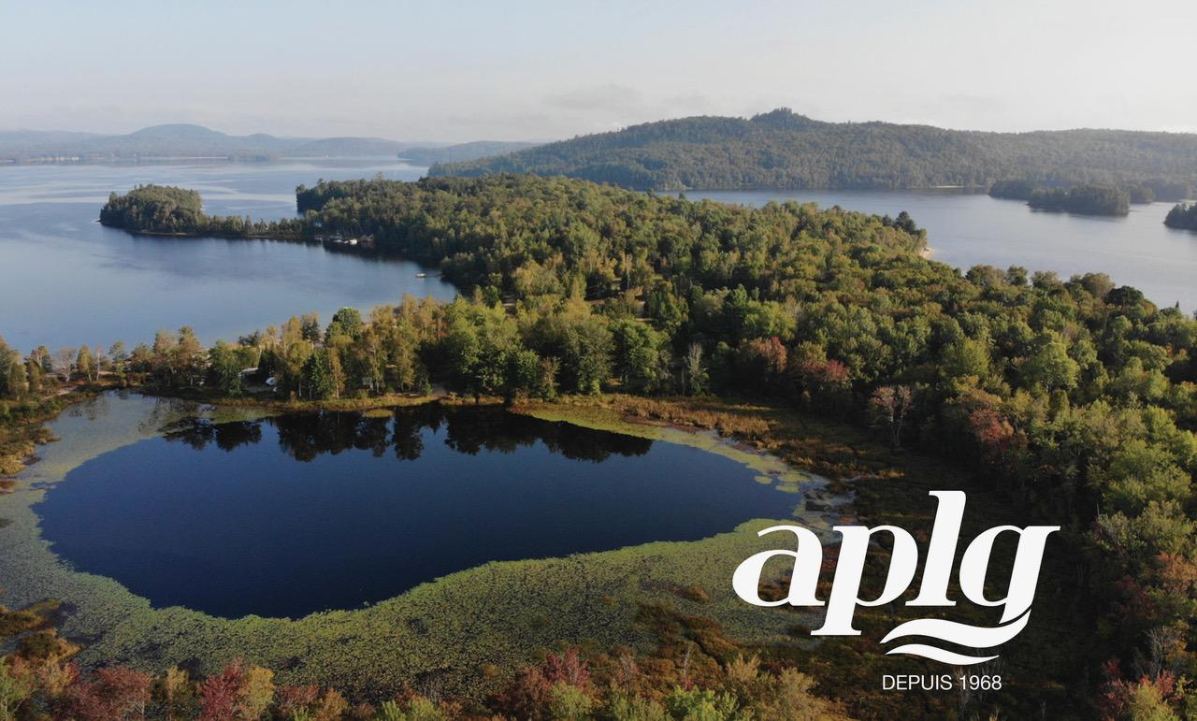

Slide 2
Assemblée générale annuelle
Le 28 juin 2026
Annual General Meeting
June 28, 2026

Slide 3
Ordre du jour/Agenda
Ouverture et mot de la présidente/Opening remarks
Adoption de l’ordre du jour/Adoption of agenda
Acceptation du procès-verbal de l’assemblée du 29 juin 2025/
Acceptance of June 29, 2025 meeting minutes
Présentation et acceptation des états financiers et du budget/
Presentation and acceptance of financial statements and budget
Mot du maire David Pharand/A word from Mayor David Pharand
Période de questions adressées au maire/Question period
Dossiers du Regroupement de protection des lacs de la Petite-Nation
  Mines
  Aire protégée Marie Lefranc Petite Nation Protected Area

Slide 4
Ordre du jour - suite/Agenda - continued
Pacte Duhamel-APLG/Duhamel-APLG Pact
Lavage et mise à l’eau des embarcations/Boat launching and washing
Bandes riveraines/Shoreline
Navigation
Aire de pique-nique/Picnic area
Plantes envahissantes/Invasive plants
Résultats des tests d’eau/Water test results
Navigation
Comité de pêche/Fishing committee
Varia
Élection des membres du Conseil d’administration/
Election of Board of Directors

Slide 5
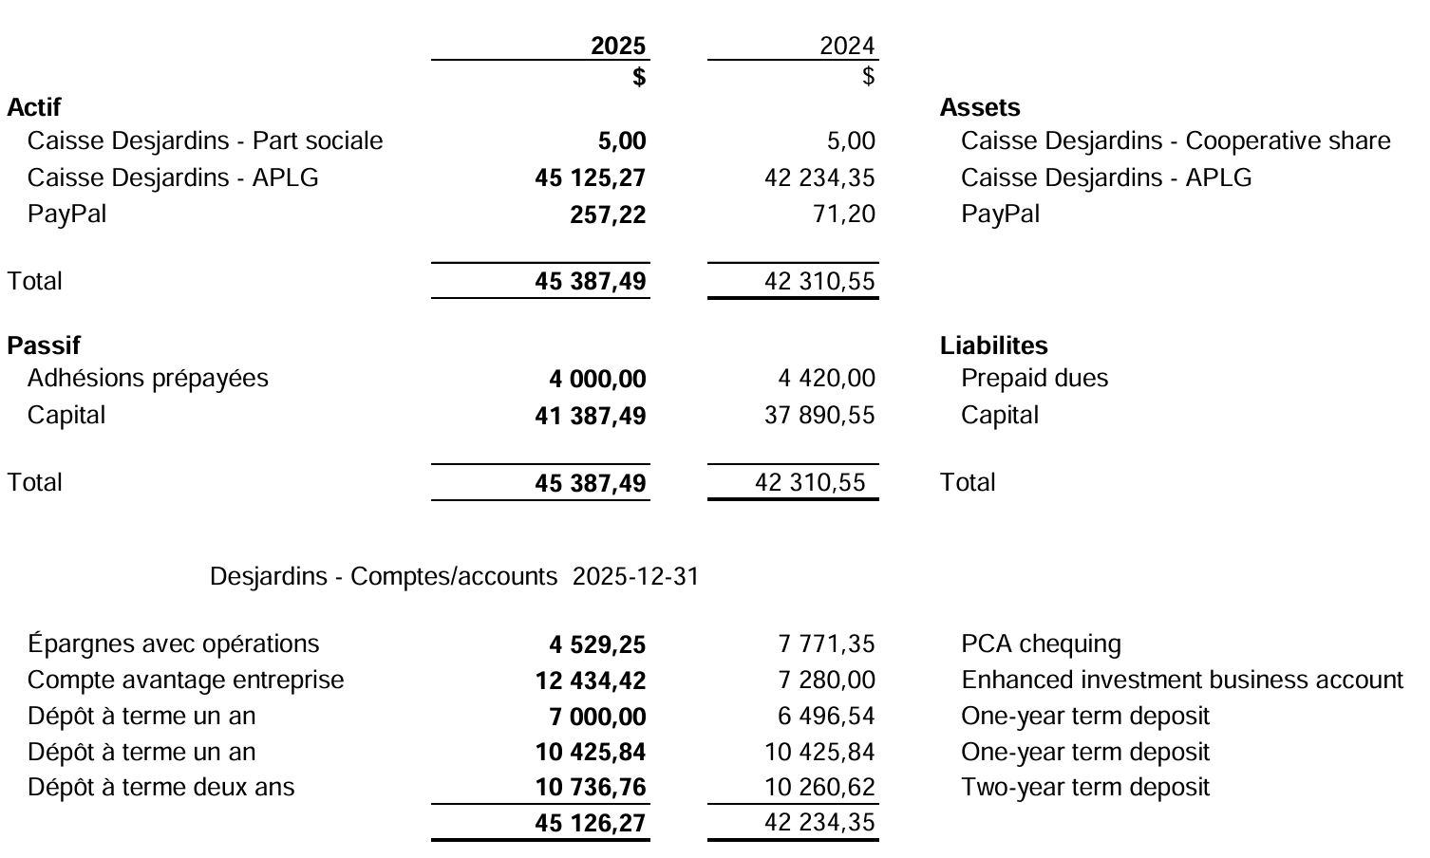
États financiers/Financial Statements – 2025-12-31
Bilan/Balance Sheet

Slide 6
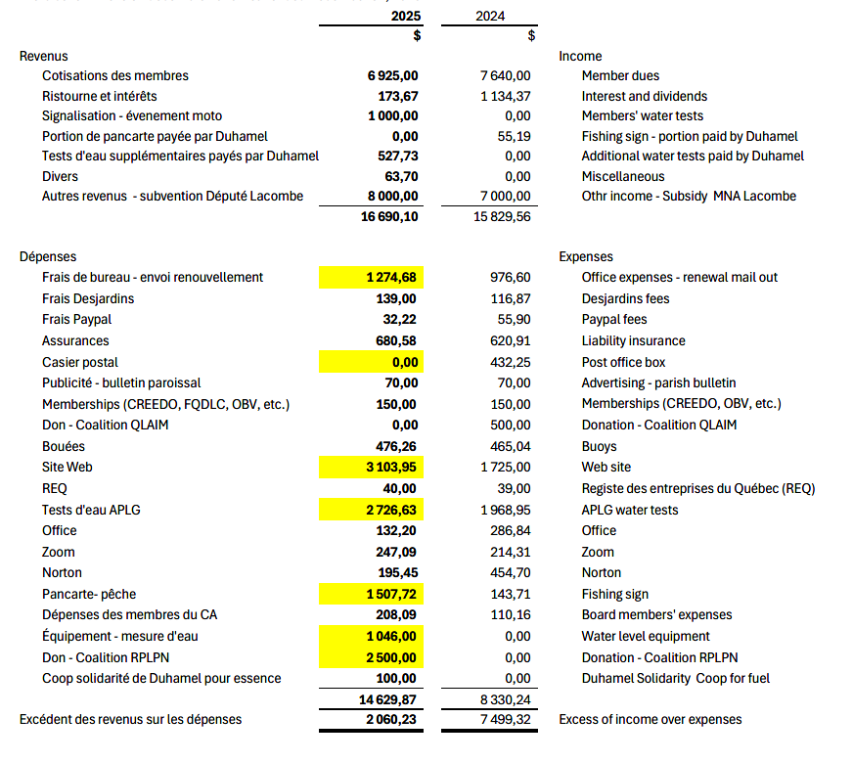
États financiers/Financial Statements – 2025-12-31
Revenus et dépenses/Income and Expenses

Slide 7
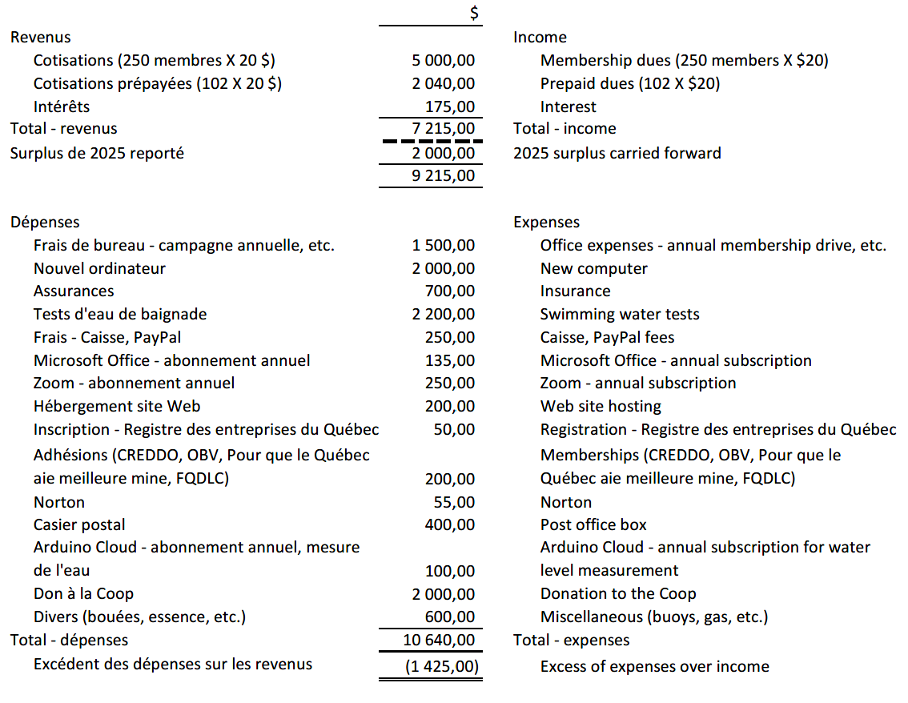
Budget 2026

Slide 9
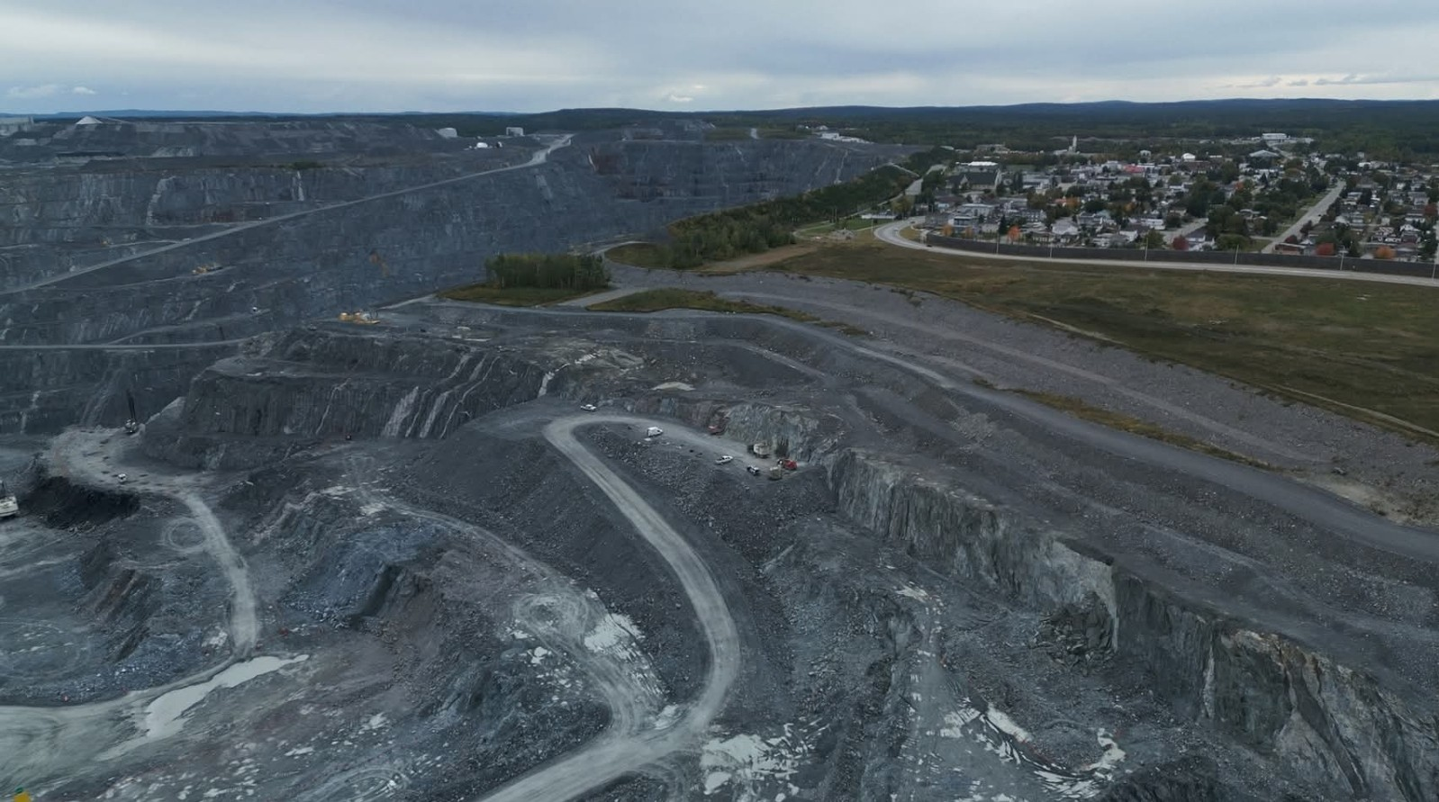
Mines

Slide 10
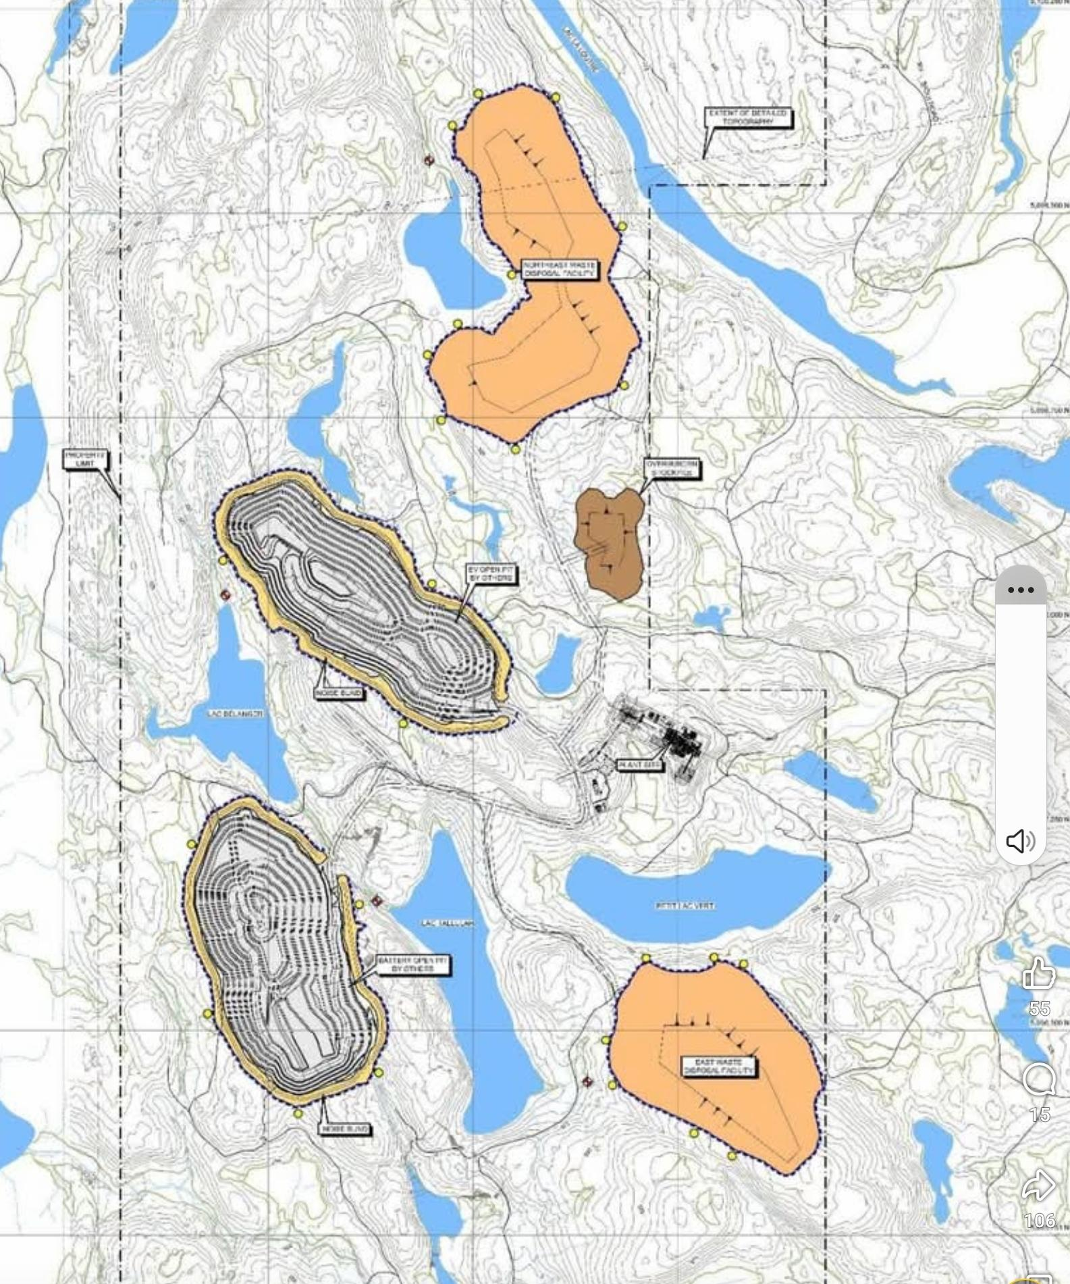
Mines

Slide 11
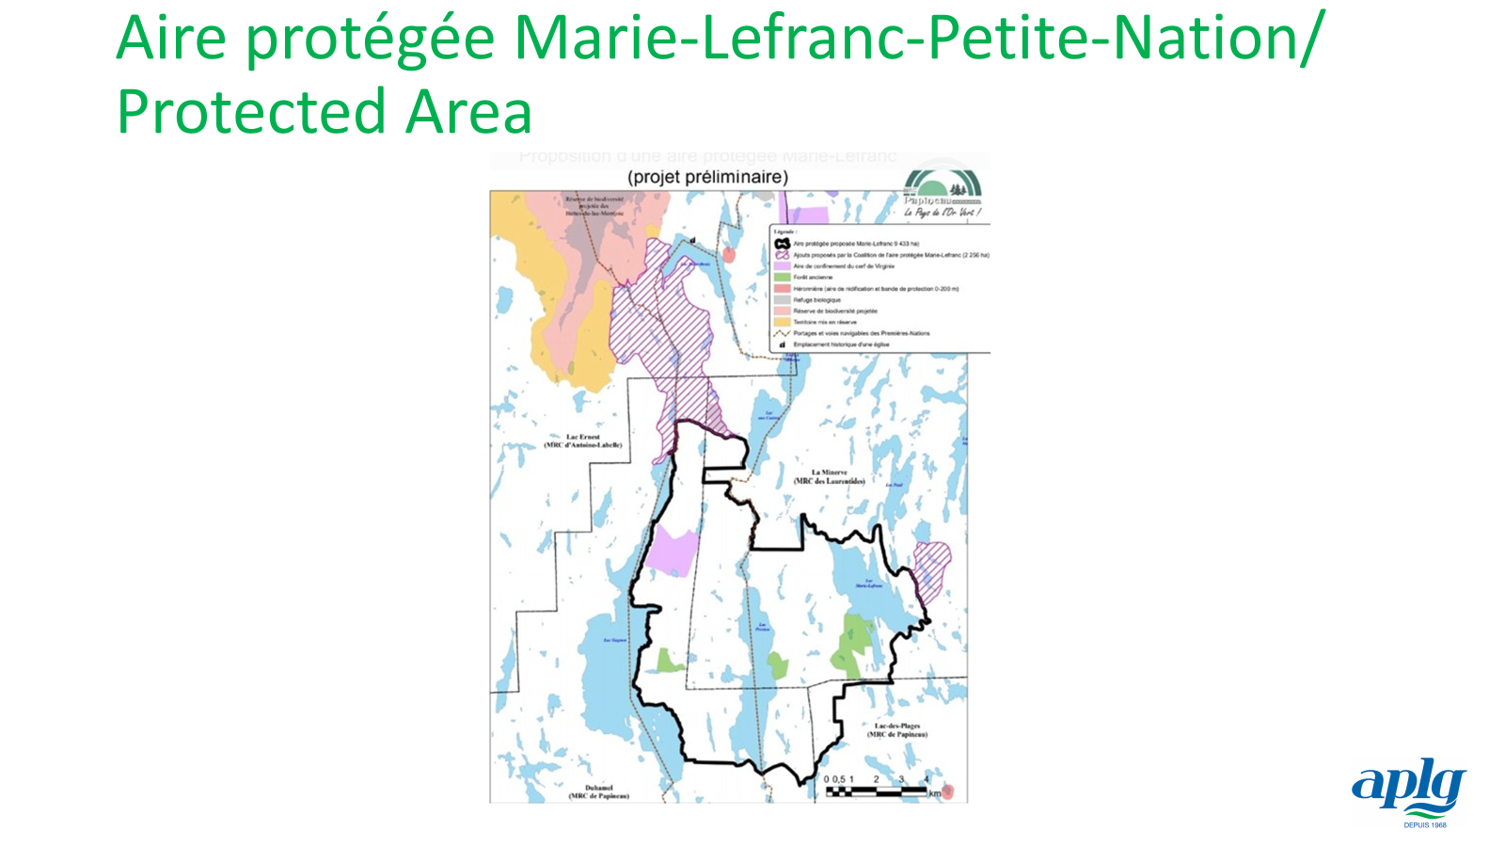

Slide 12
Pacte Duhamel-APLG/APLG-Duhamel Pact

Slide 13
Pacte Duhamel-APLG/APLG-Duhamel Pact
Lavage et mise à l’eau des embarcations/Boat launch and washing
Bandes riveraines/Shoreline
Navigation
Aire de pique-nique/Picnic area

Slide 14
Lavage et mise à l’eau des embarcations/Boat launch and washing
The new municipal bylaw on access to lakes requires that all boats and equipment be washed as soon as they have been used on another body of water.
Unfortunately, the job opening for a waterway awareness officer has not been filled.
Volunteers are raising awareness at the boat launch.
A request to ban overnight parking has been submitted.
Construction on the future boat wash facility is scheduled to begin this summer.

Slide 15

Les berges/The Shoreline
Raise awareness among all residents about the roles played by waterfront areas.
Encourage best practices.
Provide advice on renaturalization.
Work in partnership with the municipality.

Slide 16
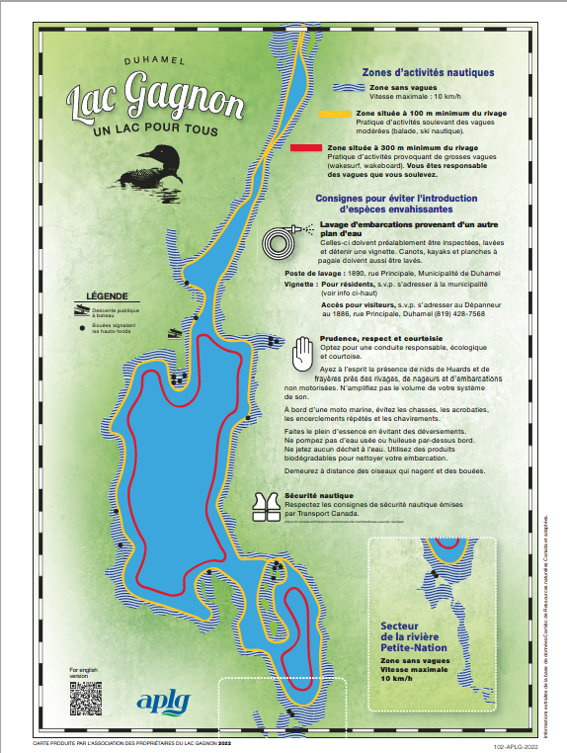
Navigation
Notre code d’éthique/
Our code of ethics

Slide 17
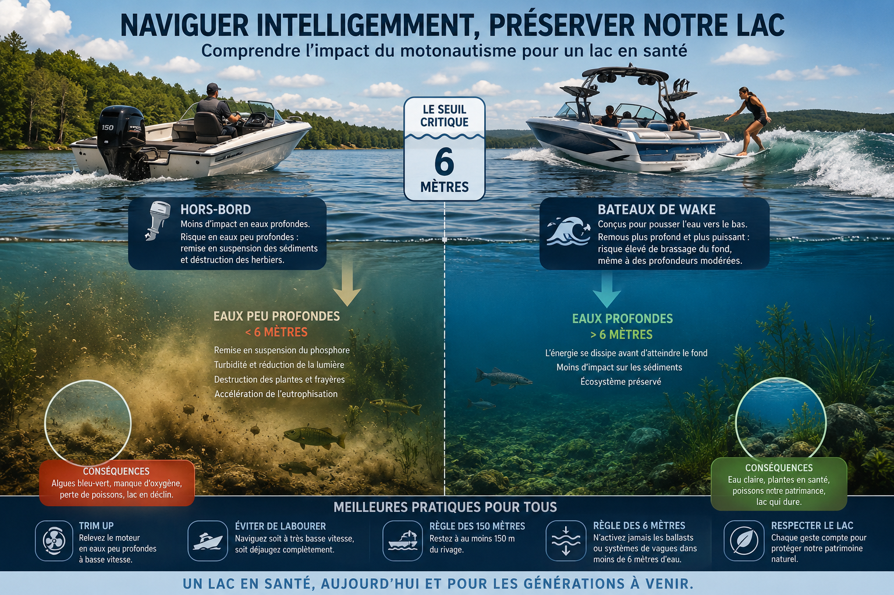
La navigation, une question de respect/It’s All About Respect

Slide 18
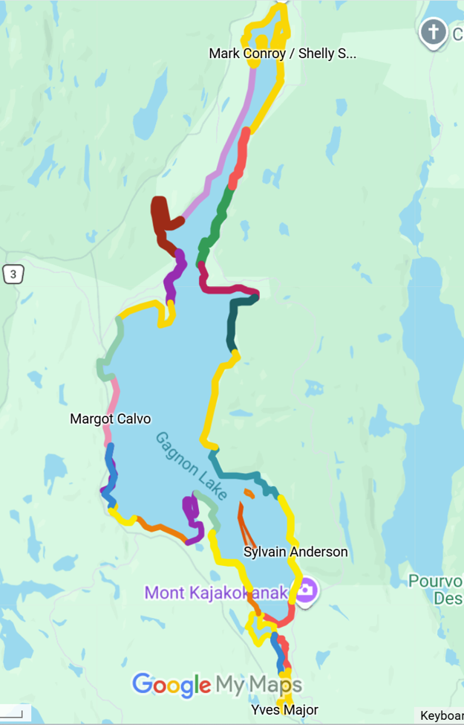
Plantes envahissantes/
Invasive Plants
Thank you to the Sentinelles team!
Would you like to join us?
Information meeting on July 12.

Slide 19
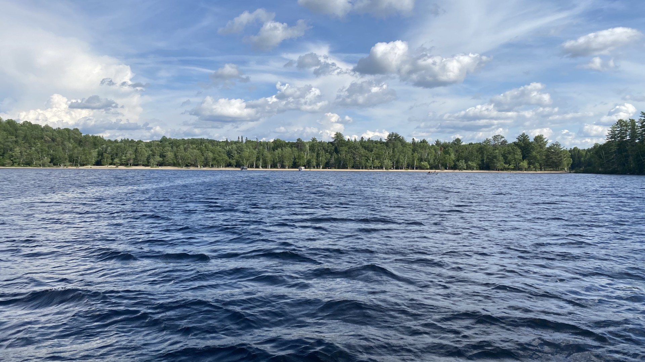
Aire de pique-nique/Picnic area
A committee has been
created
APLG
Sépaq
Municipalité
Sûreté du Québec
Project to prohibit
overnight parking

Slide 20
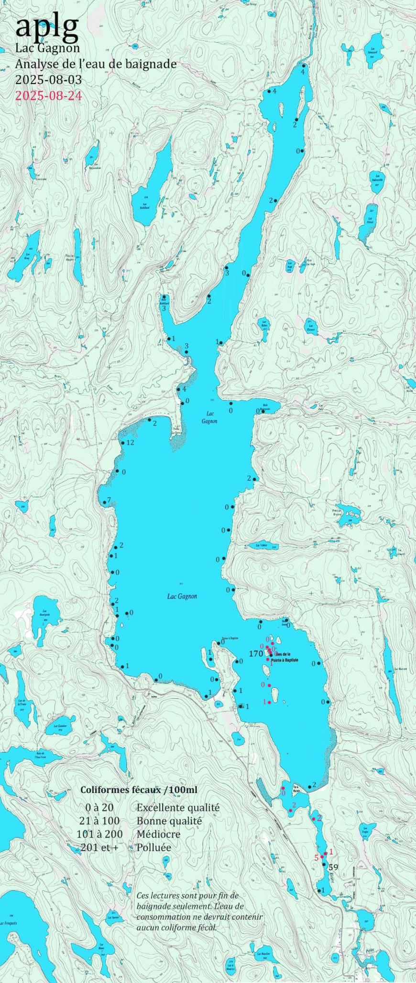
Résultats des tests d’eau
de baignade
Swimming Water Test Results
Excellent results!
Transparency samples are taken
throughout the summer.
Visit our website for details.

Slide 21
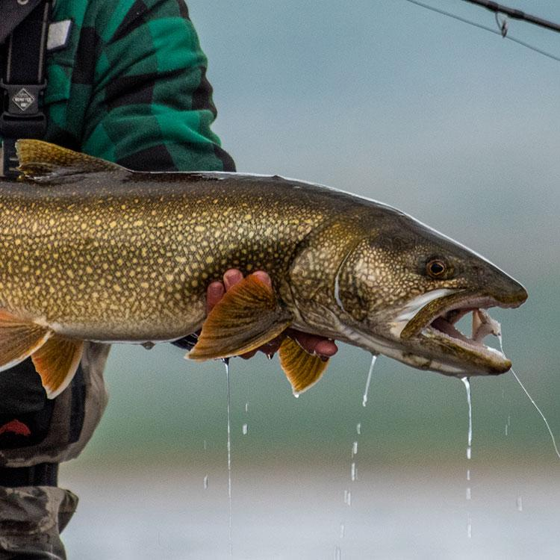
Comité sur la qualité de la pêche
Fishing at Lac Gagnon
Committee

Slide 22
Members
David Gratton
Luc Robillard
Yves Bourdages
Yves Major
Stéphane Lavigne
Comité sur la pêche/Fishing Committee
2026 Objectives
• Collaboration with the Ministry of Wildlife
An inventory of the lake is planned for 2031.
• Continue the Angler’s Logbook:
Continue collecting fishing data at the lake. Results from previous years will be posted on the APLG website.
• Angler Awareness
Raise anglers’ awareness of current regulations and best practices that promote responsible fishing. Three new posters will be installed: at the boat washing station, boat launch and COOP.
• Monitoring new species in the lake
Collect information on catches of walleye, muskellunge, and northern pike.

Slide 23

Comité sur la pêche/
Fishing Committee

Slide 24
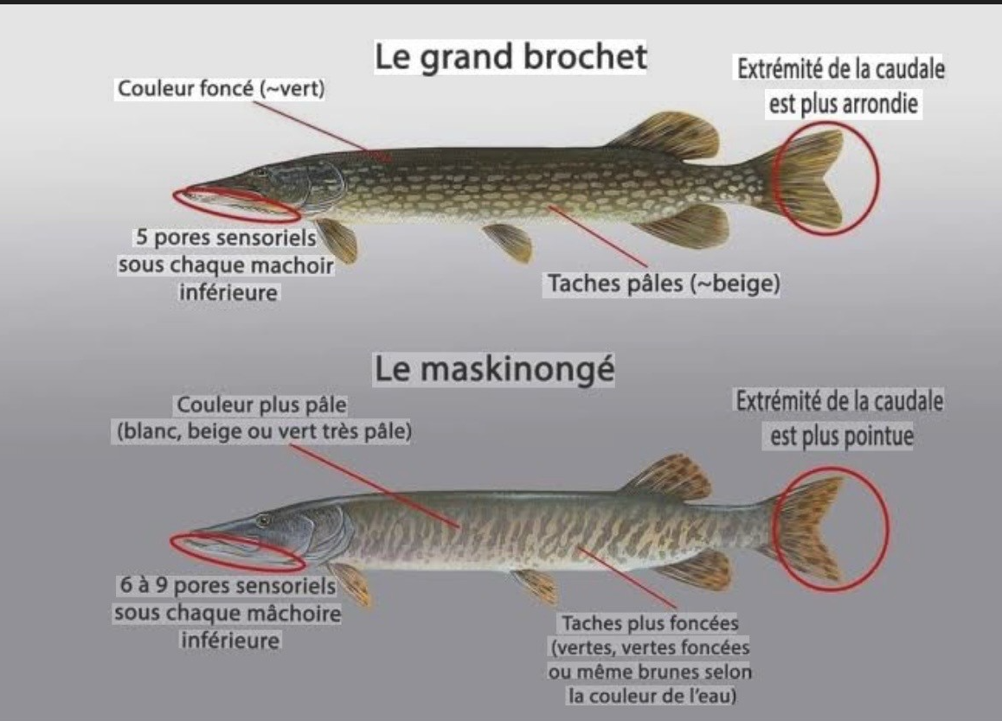
Comité sur la pêche/
Fishing Committee

Slide 25
Mireille Tousigant: Présidente, Plantes envahissantes, Comité protection du lac / President, Invasive plants, Lake Protection Committee
Anne Wells: Vice-présidente, Trésorière et Traductrice / Vice-President, Treasurer and Translator
Pierre-Émile Rocray: Secrétaire, santé du lac / Secretary, Lake health
Sylvain Anderson: Santé du lac / Lake health
Olivier Bodard, Site web, Facebook, Niveau du lac / Website, Facebook, Lake level
Mark Conroy: Navigation
David Gratton: Dossier Pêche / Fishing Committee
Paul-André Laurin: Santé du lac / Lake health
Paul St-Georges: Santé du lac / Lake health
Louis St-Hilaire: Aire protégée, dossier minier / Protected area, mines
Élection des membres du Conseil d’administration/
Election of Board of Directors

Slide 26
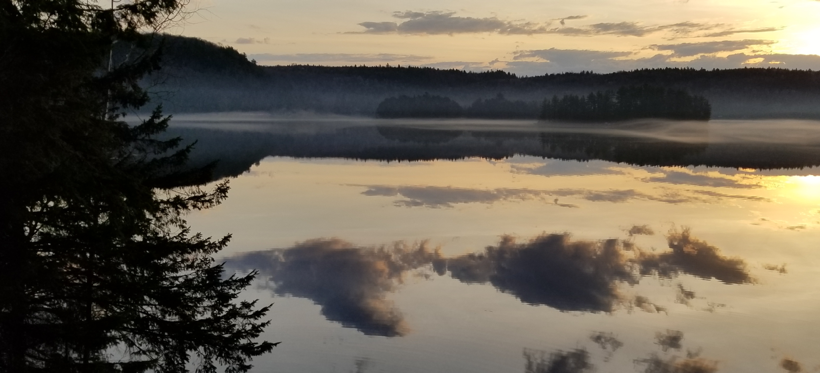
Protégeons notre lac en nous impliquant/Getting involved to protect our lake

